Slide 1



TEAM
• TEAM NAME : ELYSIAN
• MEMBER NAMES : SHRIYANSH RAJ SAHU [LEADER]
NIHARIKA NUPUR [HARDWARE ENGINEER]
SAKSHI KUMARI [DEVELOPER]

Slide 2









PROBLEM STATEMENT & THEME: VISION-BASED AUTONOMOUS ROBOT
PROBLEM
IMPACT
01
Most robots today need a human to control them with a remote or joystick.
Less human effort for repetitive delivery and carrying tasks
Safer in places that are risky or hard for people to work in
Low-cost automation becomes possible for small businesses and students
Can help in hospitals, warehouses, hotels and homes
02
Robots that can drive themselves usually need expensive sensors (like LiDAR) or pre-built maps, which makes them too costly for small businesses, schools and startups.
THEME ALIGNMENT
AI / Computer Vision
the robot detects objects and people using a vision model
Robotics
motors, sensors, navigation and obstacle avoidance
03
Simple robots can’t understand what they see. They can’t tell a person from a wall.
Embedded systems
a microcontroller runs the hardware in real time
Vision-Language Models (VLM)
an optional extension so the robot can follow plain-language goals
Today’s autonomous robots are expensive and complicated, so most people can’t use them.
Our project shows that a robot can see its surroundings, understand them with AI, and reach a goal on its own using low-cost, easily available parts.

Slide 3















SOLUTION
SOLUTION OVERVIEW
KEY FEATURES
UNIQUE VALUE
A small robot with a camera
that sees the environment
Real-time object and
person detection
Very low cost
built with affordable, easily available parts
Autonomous navigation
to a given target
No pre-made map or track needed
it works in a new space
An AI model that identifies
objects and people in real time
Obstacle avoidance (ultrasonic
sensor as a safety layer)
Decision logic that steers
the robot toward the target
Free, open-source AI
uses AI that has already been trained
Searches by rotating if the
target is not visible
Sensors that stop it from
hitting obstacles
Easy to upgrade
new objects or goals can be added in software
Stops automatically when
it reaches the goal
It moves with no human
driving
Beginner-friendly
simple logic that anyone can understand and extend
Works with a standard camera
and no special hardware
Our robot works like a person walking to a destination. It looks around, spots the target,
decides which way to turn, and walks toward it, avoiding anything in the way.
Notes:
Say clearly: No human is controlling this robot. It sees, decides and moves on its own. This is the hackathon's Summit Condition.

Slide 4



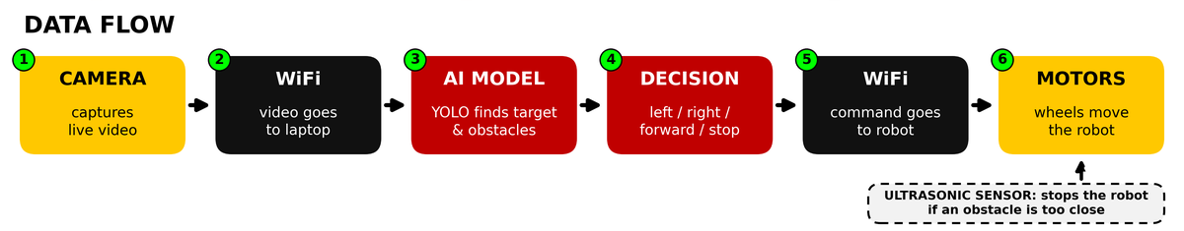
ARCHITECTURE
TECH STACK
HARDWARE
SOFTWARE
COMMUNICATION
ESP32-CAM (Eyes): sees the surroundings.
ESP32 / Arduino (Controller): takes the decision and runs the robot’s parts.
L298N driver + DC motors (Movement): moves the robot.
Python (Language): the main program is written in it.
OpenCV (Vision-tools): reads and processes the camera video.
YOLOv8-nano (Detector): the AI model that finds objects and people.
WiFi (Link): connects the robot and the laptop.
Video stream (Sight): camera video goes from the robot to the laptop.
Commands (Orders): forward, left, right or stop goes from the laptop to the robot.

Slide 5
MARKET RESEARCH/ANALYSIS
Demand for automation is rising everywhere, especially in logistics and healthcare. Our low-cost design opens the market to smaller customers that big, expensive robots can’t serve.
TARGET USERS
MARKET SIZE
POTENTIAL REVENUE MODEL
Warehouses & logistics
Estimates differ between research firms, but all show strong growth.
1
companies
Robot-as-a-Service
Hardware sales
AUTONOMOUS MOBILE ROBOTS
monthly rental or
subscription
low-cost kits for
schools and hobbyists
Hospitals
USD 2.75B → 7.07B
2
carrying supplies, guiding visitors
2026 → 2032 | CAGR 14.4%
Software licensing
Custom solutions
Hotels & restaurants
Source: MarketsandMarkets
3
2026
2032
navigation software for
other robot makers
setup and maintenance
for businesses
delivery robots
ALL MOBILE ROBOT TYPES (BROADER)
4
Small factories
US$33B → 68.9B
EXPECTED GROWTH
& workshops
14–20%
Schools & colleges
2026 → 2030
growth per year
5
Source: ABI Research
forecast, depends
on the source
STEM and robotics learning
2026
2030
▲ Logistics: fastest-growing segment
6
Homes
Vision guidance = highest CAGR
▲ Asia Pacific: fastest-growing region
assistance for elderly people
Vision-based robots like ours are in the fastest-growing area.
good news for a team in India

Slide 6
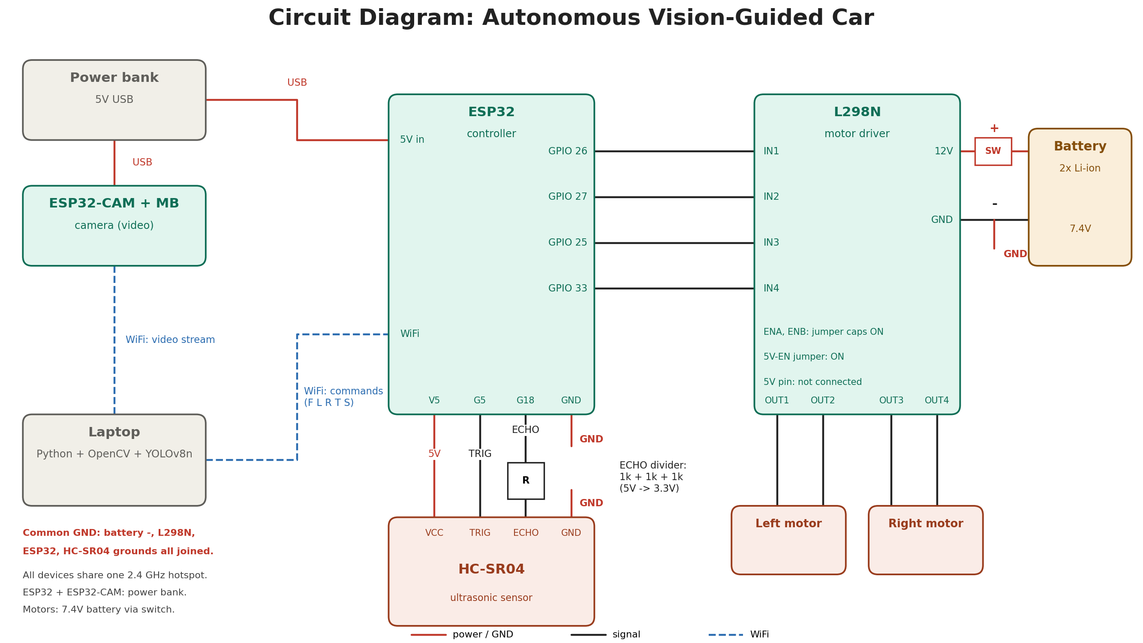
CIRCUIT DIAGRAM

Slide 7
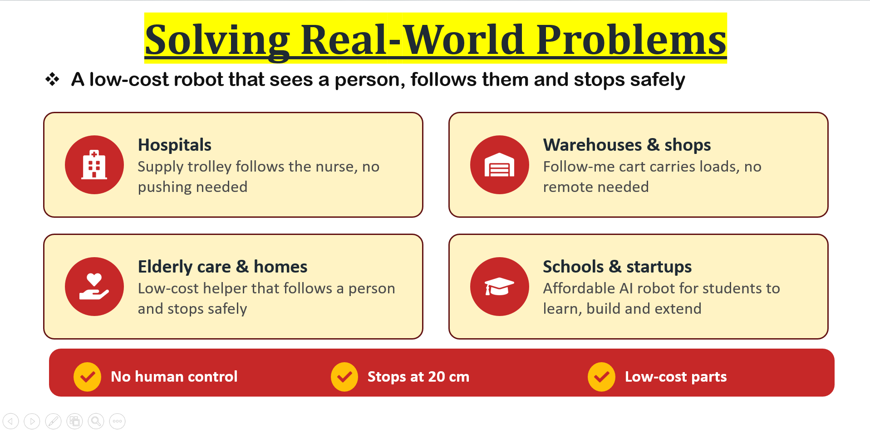

Slide 8
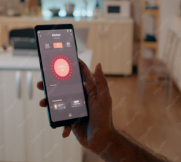
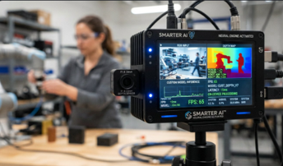


FUTURE SCOPE
Mobile App Deployment:
AI Model Improvement:
Enterprise Integrations:
Scaling to Global Users:
Control and monitor the robot from a phone: live camera feed, battery status, goal setting
Type or speak a command (“Go to the reception desk”) using the VLM extension
Works over Wi-Fi/Bluetooth, with no special hardware needed
Move to lighter, faster models (e.g., YOLO-nano or Mobile Net variants) so detection runs smoothly on low-cost hardware
Add depth estimation from a single camera so we don’t need LiDAR
Continual learning: the robot improves from new environments by collecting hard cases and retraining
Better VLM understanding of multi-step goals (“Pick up the box and take it to room 3”)
Plug into hospital, warehouse and hotel systems via APIs (inventory, room service, task queues)
Fleet management dashboard: assign tasks to multiple robots and track performance
Safety and compliance features: person-aware slowing/stopping, audit logs
Open-source SDK and a low-cost robot kit for schools and startups
Multilingual voice and text commands
Cloud model updates pushed to all robots
Affordable pricing tiers: students, small businesses, enterprise
Impact: a non-technical user (a shopkeeper or teacher) can operate it in minutes
Impact: higher accuracy, lower cost, and less dependence on lighting and layout
Impact: moves from “cool demo” to “usable business tool”
Impact: democratizing autonomy, so a robot is not only for companies that can afford LiDAR

Slide 9



EXTRA(OPTIONAL)
Research & References
01 — Computer Vision & Object Detection
02 — Autonomous Navigation & Safety
03 — Vision-Language Robotics
YOLO and OpenCV provide the foundation for identifying people and objects in camera frames. Detection results can inform the robot’s movement decisions.
Robotics navigation combines goal-directed movement, sensor feedback and obstacle handling. A proximity sensor can provide an additional stop condition.
Vision-language-action research explores how robots can connect visual information and everyday instructions with physical actions. This supports our proposed future scope.
Reference: Ultralytics YOLO documentation
Reference: ROS 2 Navigation (Nav2) concepts
Reference: Google DeepMind’s Gemini Robotics research
Ultralytics- https://docs.ultralytics.com/
ROS 2 Navigation Concepts- https://docs.nav2.org/rolling/getting_started/navigation_concepts/
Google DeepMind- https://deepmind.google/en/models/gemini-robotics/
IEEE Institute- https://www.ieee.org/publications-research

Slide 10
Thank
you!

